Slide 1

Advanced Web Development
Building full featured web applications

Slide 2
Table of contents
01
02
03
04
Building a full featured web app
Web Application frameworks
APIs and Databases
Structuring your projects

Slide 3
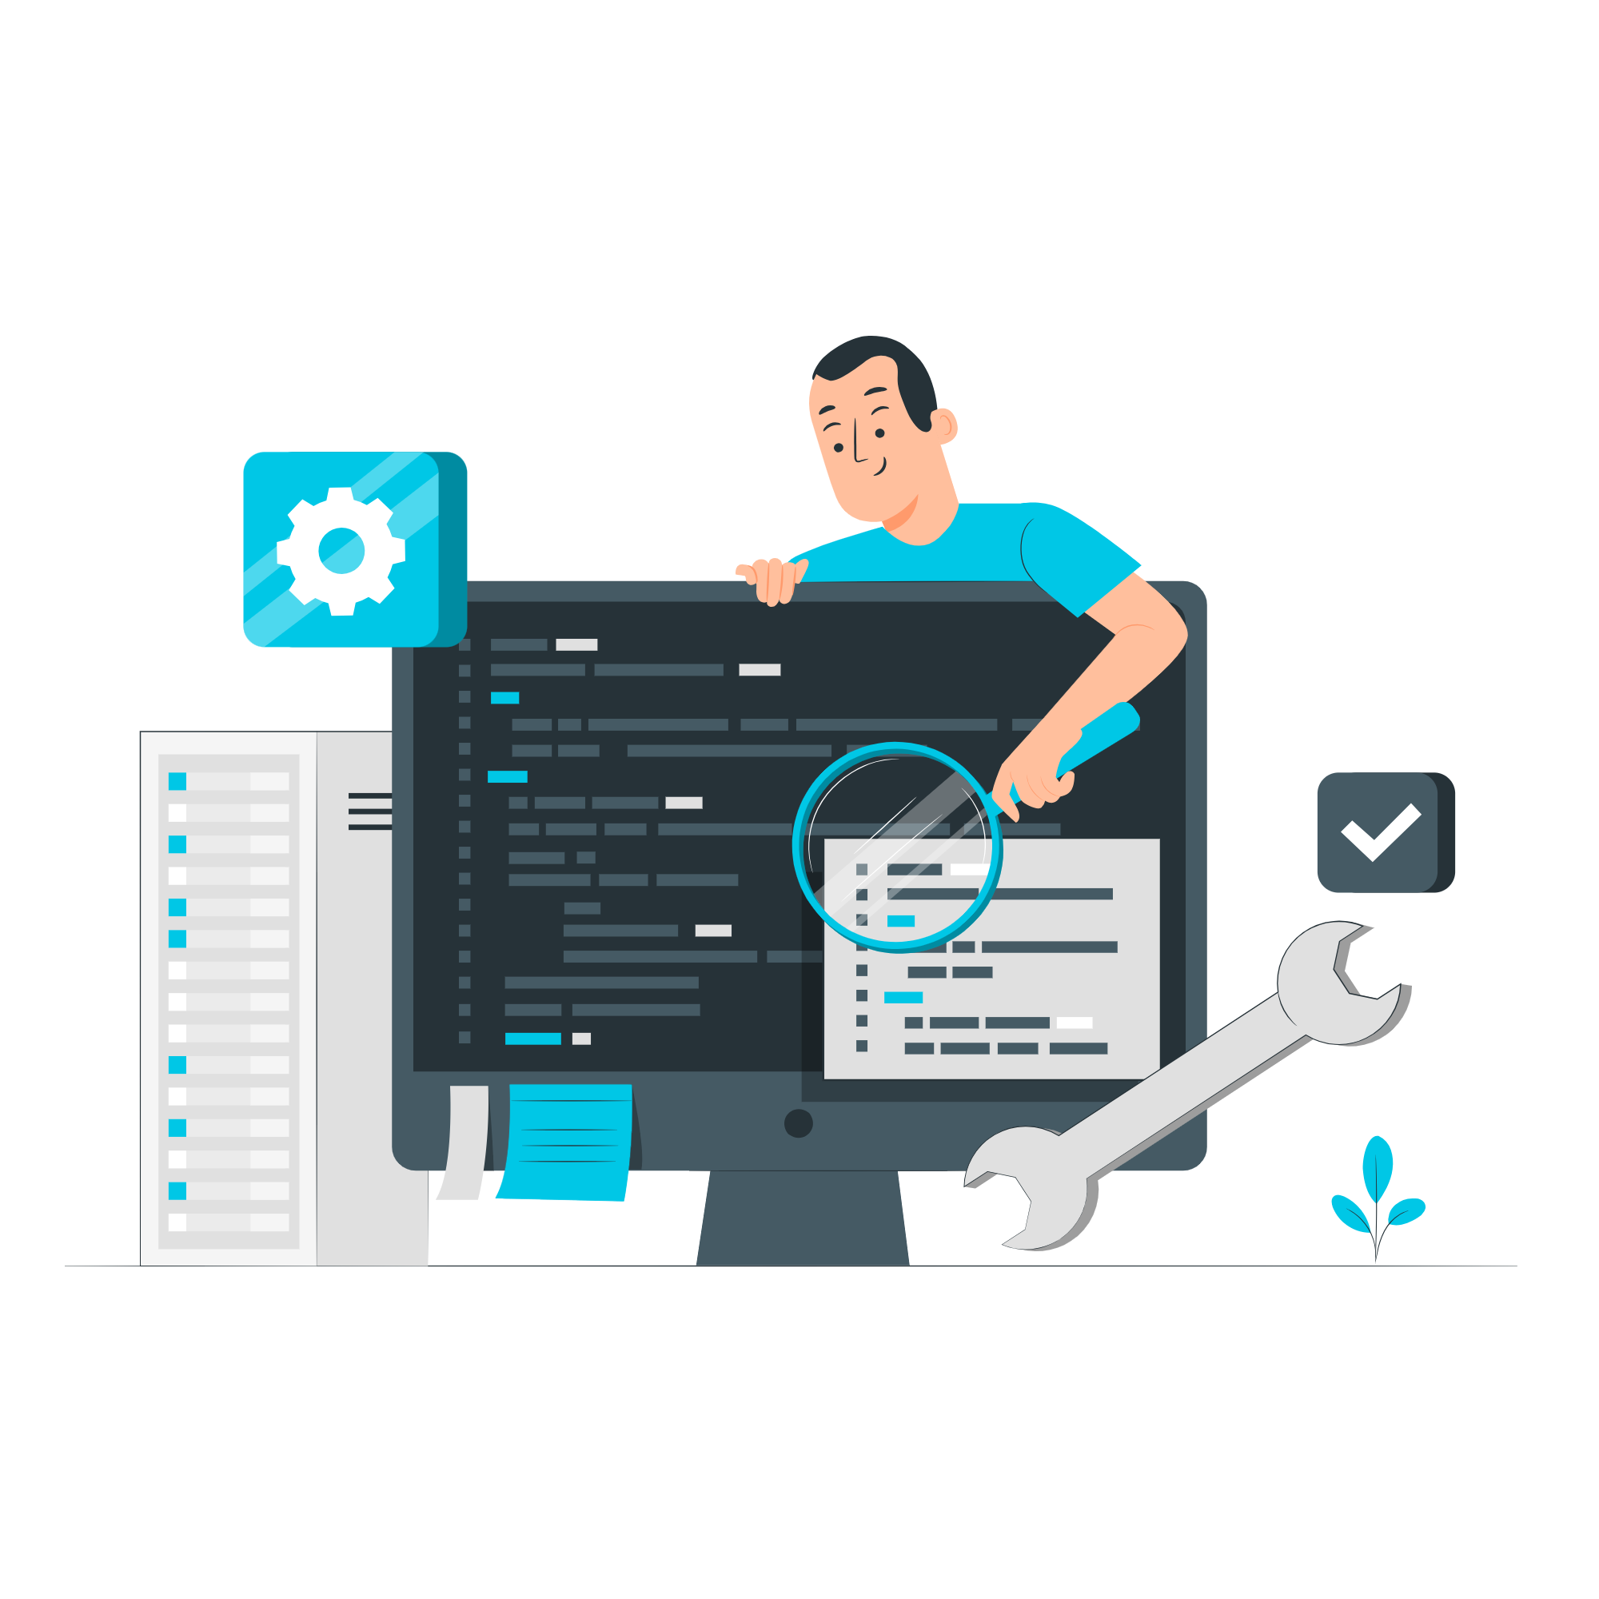
Building a full featured web app

Slide 4
Full stack applications
Covers the entire spectrum of an application's development, from the user interface (UI) to the server-side logic and database management.
A fullstack developer merges these aspects into one fully functional system
Key Technologies:
Front-end: HTML, CSS, JavaScript
Back-end: Django (Python), Ruby on Rails (Ruby), Express (Node.js), Laravel (PHP), Spring Boot (Java)
Databases: MongoDB, MySQL, PostgreSQL, Oracle
APIs: REST, GraphQL

Slide 5

FRONTEND
Concerned with aesthetics
What the end user sees and interact with.
Handles client-side logic

Slide 6

BACKEND
Behind the scene
Concerned with functionality, server-side components and infrastructure.
The user doesn’t see but indirectly interacts with the application logic through the frontend

Slide 7

DATABASE
Store of information
Could be structured or unstructured.
The most sensitive part of the system due to what it contains.

Slide 8

API
Application Programming Interface
Enables applications to interact with each other sharing services.
Acts as the connector between the different parts of the system.
Uses a request-response cycle.
Could be Web APIs, database, local or even remote.

Slide 9

THE AVATAR
Master of all four elements
Is it possible to become one? Maybe
Job requirements:
Proficiency in frontend development
Proficiency in backend development
Must manage databases
Can fly
Must heal the sick and perform dark arts

Slide 10
Bytes for thought
How long would it take to create Facebook using plain HTML, CSS and JavaScript.
One month, two months, a year, never???
Potential issues: Manageability, scalability, reusability, security.
Too stressful

Slide 11

Web Application Frameworks
A "construction kit" for building houses. Instead of starting from scratch, you get pre-built walls, doors, and windows (components) to assemble your application.
Efficiency: pre-built tools and libraries.
Structure: Enforce a clear structure e.g MVC
Security: Inbuilt security features against common vulnerabilities.
Community Support: Frameworks have large communities.

Slide 12



Main frameworks are available for your favorite language
Javascript/Typescript
Python
Rust
Vite, Angular, Vue
Node js (Express), Fastify, Nest, Next
Django, Flask, FastAPI
Actix, Rocket

Slide 13

Choosing the right framework for you
Project requirements: Lightweight or scalable
Language familiarity: A JS developer using Rust frameworks, keep on playing
Opinionated vs unopinionated.
Community Support: Imagine using Gleam to code????
Ecosystem and plugins: No need to build all functionalities from scratch.

Slide 14
Vite + NestJS
Vite is sort of a drop in for CRA, has a large community, supports a lot of plugins(just browse the internet) and is non opinionated.
NestJS, though has a steep learning curve, is beneficial on the long run. Scalable due to its enforced structure and is built on Express, Fastify, supporting a lot of plugins as well
My goto as a typescript developer, and would recommend to anyone on the long run.

Slide 15
Unrelated but…
React is NOT a framework

Slide 16




Alrightyyyyyy, we have our brain and senses
Vite
Express
LOCKED
LOCKED
How do we communicate with our other senses or even remember

Slide 17
Databases
Worried about structure and consistency, use an SQL database
Structure is not a problem, NO-SQL it is.
In memory databases also exist but won’t be explored for the scope of the workshop
Your browser also has a store of information (local storage), so not everything needs to be stored on the server, especially sensitive information.
You can use ORMs (Object Relational Mappers) to aid with complex queries
We’ll use MongoDB (a NO-SQL DB for this)

Slide 18
APIs
Set of rules and protocols, allows software to interact with one another.
Enable communication between different systems (e.g., frontend and backend).
Allow third-party integrations
REST API: Most popular, uses HTTP methods like GET, POST, PATCH, PUT, DELETE
GraphQL: Single endpoint, highly customizable, get what you need.
We’ll use REST due to its high adoption and ease of use

Slide 19


Alrightyyyyyy, we have our full system
Vite
Express
Mongo
REST API
Let’s gooooo, Zuckerburg mode

Slide 20

WAITTTTTTT
We have the tools, yes
How do we actually use them to ensure optimal performance ???
We need structure

Slide 21
Structuring you full stack app
Abstract Idea
Folder structure
Tech Stack
Sprint methodology
Proper structure and documentation for others to visit and ease of continuity. Pick and follow a consistent pattern.
Naming conventions, file storage pattern etc
Pick the appropriate tools to ensure maximum productivity, this includes tesing, deployment, security etc
Feature rollout, parallel or sequential
For a high integrity system, sequential, starting from backend to frontend

Slide 22

Time to get out hands dirty

